Slide 1
Machine Learning 1&2 – US Mortgage Loans - Probability of Default Prediction
Nam Hoang 370134

Slide 2
Table of content
Project briefing
Characteristics of underlying data
Project roadmap
Results discussion

Slide 3
Project briefing
Data: 50,000 mortgage-loan-level data collected from the portfolios underlying U.S. residential mortgage-backed securities (RMBS) securitization portfolios over 60 periods provided by IFR (www.internationalfinancialresearch.org)
Objective: To predict probability of default of mortgage loans aggregated at period level.

Slide 4
Characteristics of underlying data
Target variable is dichotomous
Independent variables include:
Loan-specific variables (LTV, loan balance, type of borrower, time to maturity, real estate type, etc.)
Regional variable (state)
Macro variables (gdp, unemployment rate, house pricing index)
Imbalanced dataset with negative/positive class ratio 97.5/2.5
Negative class overrepresents in any strata/bins
How the imbalanced data is being addressed in this project:
SMOTEENN sampler is used to artificially inflate minority class while at the same time reducing observations from majority class
Parameter Class_weight is set to ‘Balanced’ on those classifiers that support such functionality

Slide 5
Project roadmap
Data exploration
Histogram for distribution of defaults on explanatory variables
Boxplot for outlier detection
Feature engineering
Feature creation: Additional economic variables were created based on domain knowledge. Lagged macro variables were also created due to lagging effect of macros on default rate.
Variable encoding: One-hot-encoding is applied on state variable to account for regional effect on default rate
Model fitting
Logistic Regression
KNN Classifier
Performance evaluation
Scatterplot for distribution of defaults
Feature selection: Chi2 Contingency test (for dichotomous variables), Point Biserial Correlation, Weight of Evidence and Spearman correlation (for continuous variables)
Feature scaling: Robust scaling is chosen for continuous variables mainly due to strong presence of outliers.
Support Vector Classifier
Random Forest Classifier
AUC + Brier Score (loan level)
MAE + MSE (aggregated level)
Calibration Curve (aggregated level)
Data sampling
Create 5 datasets by randomly selecting 10,000 loans out of 50,000 (without replacement) and ensure that the negative/positive ratio is close to 97.5/2.5
For each dataset, a 80/20 split is applied to create training and testing sets.
Missing data is imputed using MICE algorithm (it is a multivariate method to impute missing data by taking into account data from other variables)
SMOTEENN is employed to artificially oversample minority class while reducing majority class (partially reduce the severity of imbalanced data)
XGBoost Classifier
LightGBM Classifier
Deep Neural Network
Bayesian optimization is used for hyperparameter tunning
Class_weight is set “Balanced” whenever possible
Because all the classifiers will predict negative outcome in most of cases, relying on AUC and Brier score can give a false sense of accuracy, it is recommended that probability measure needs to be supplemented with MAE, MSE and Calibration curve to estimate how far predicted probability is away from actual probability on an aggregated level (period).
Notes:
Because all the classifier will predict negative outcome in most of cases, relying on AUC and Brier score can give a false sense of accuracy, it is recommended that probability measure needs to be supplemented with MAE, MSE and Calibration curve to evaluate how far predicted probability is away from actual probability on an aggregated level (period).

Slide 6
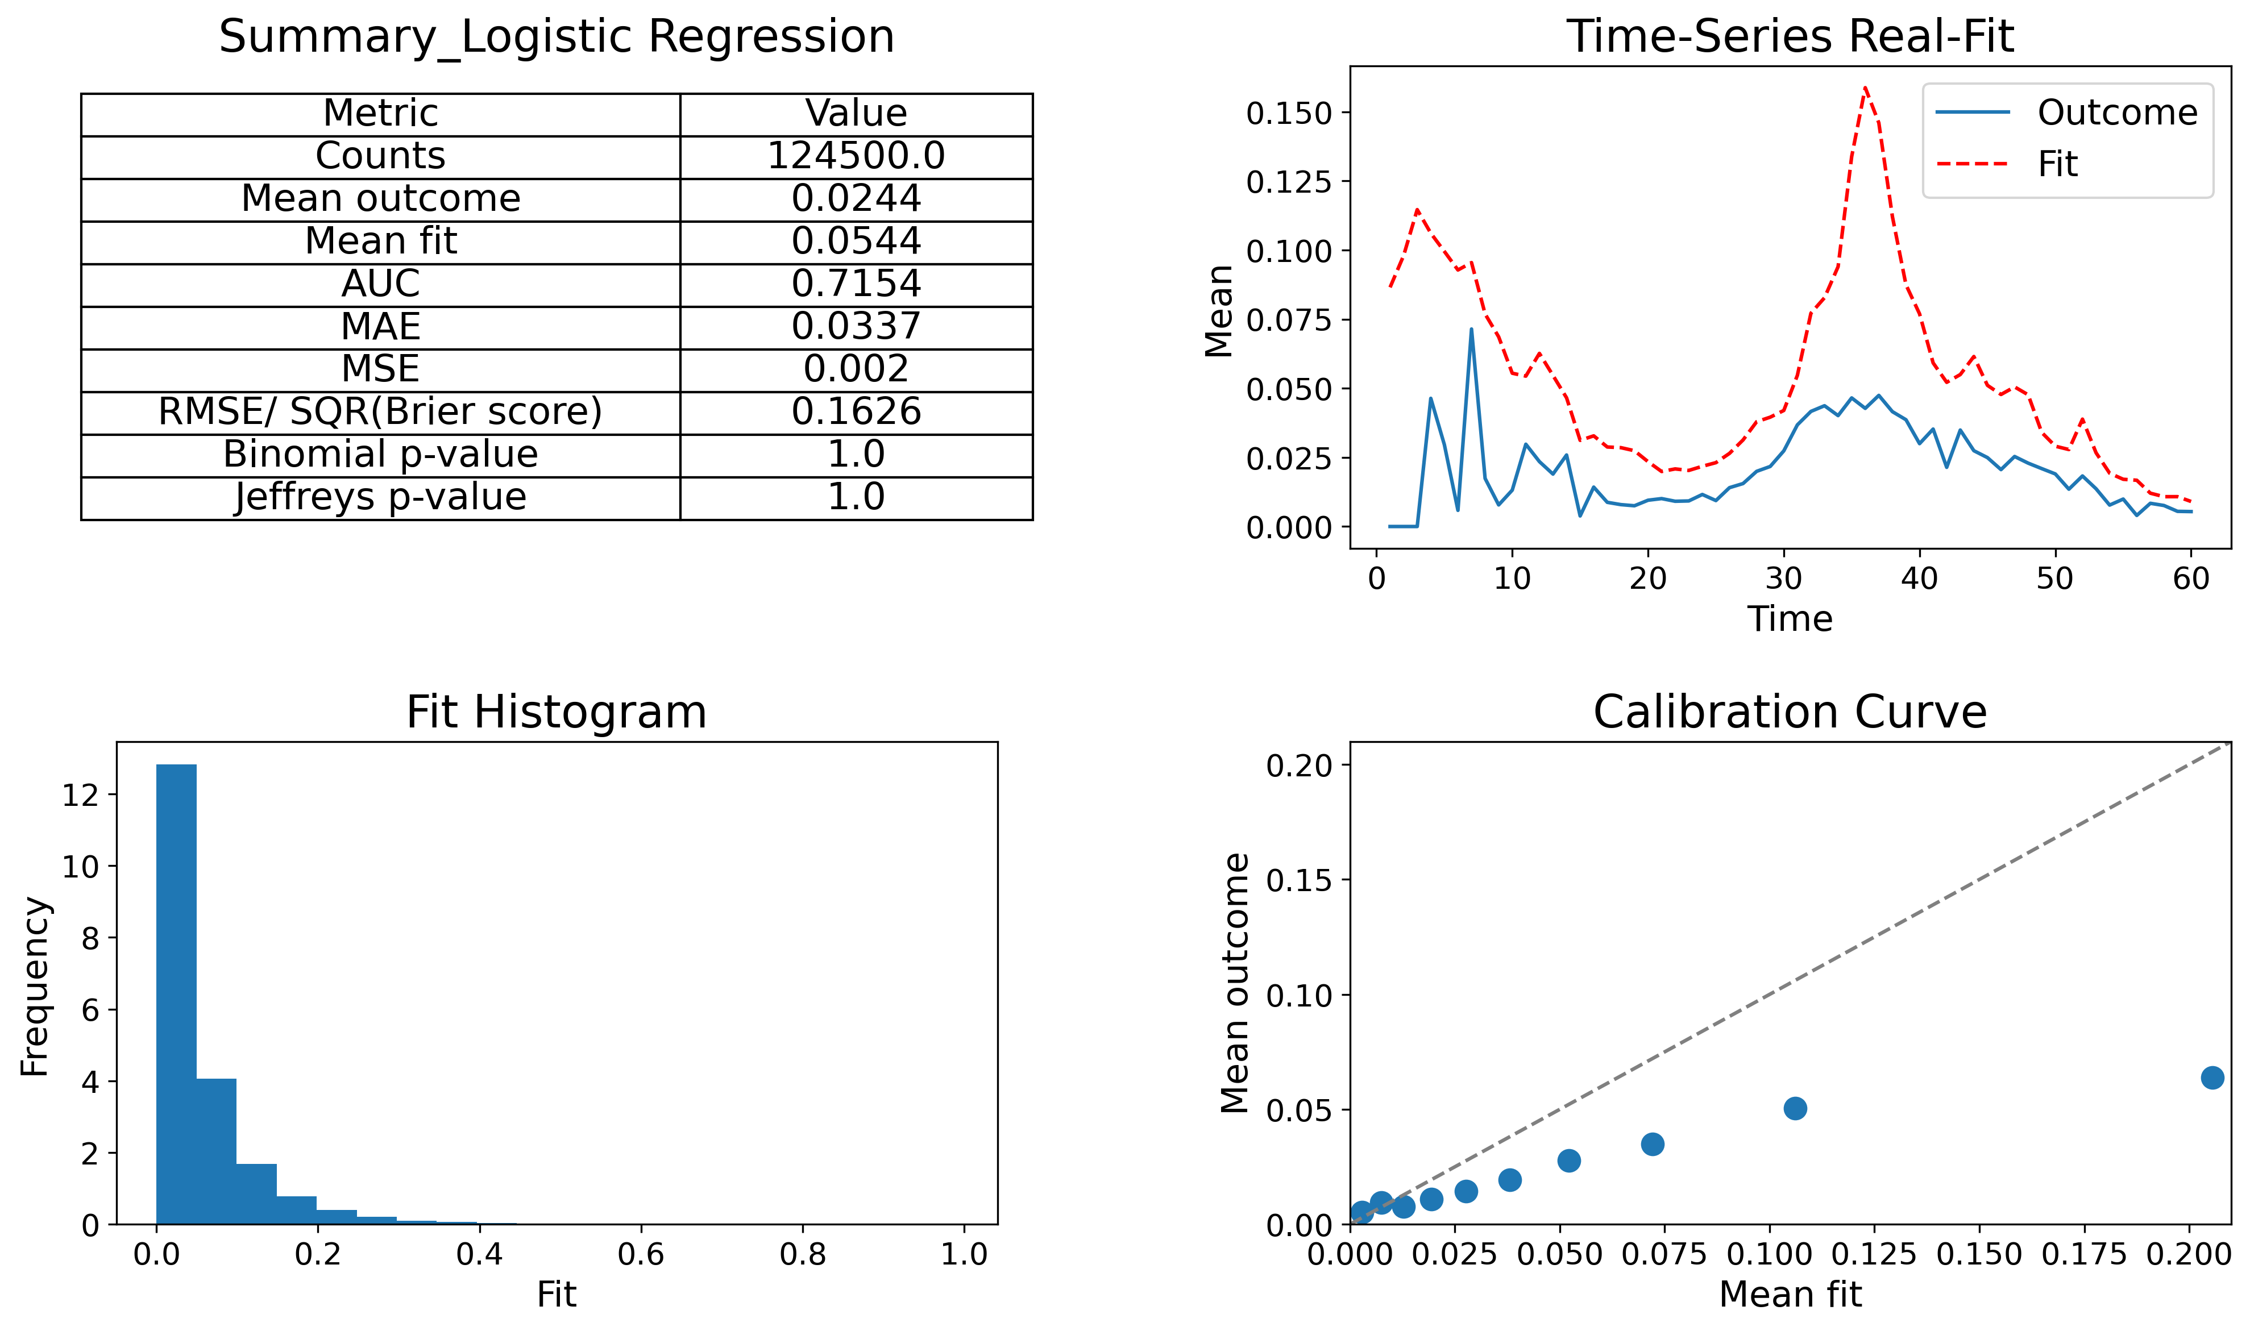
Performance evaluation
Notes:
AUC tends to tell if a classifier does a good job at labelling data. If we see a high AUC in the context of imbalanced data, it could mean that the classifier does a good job at labelling majority class correctly. However, the same conclusion might not be drawn for the minority class
To tackle this problem, the AUC needs to be supplemented with MAE, MSE and calibration curve

Slide 7
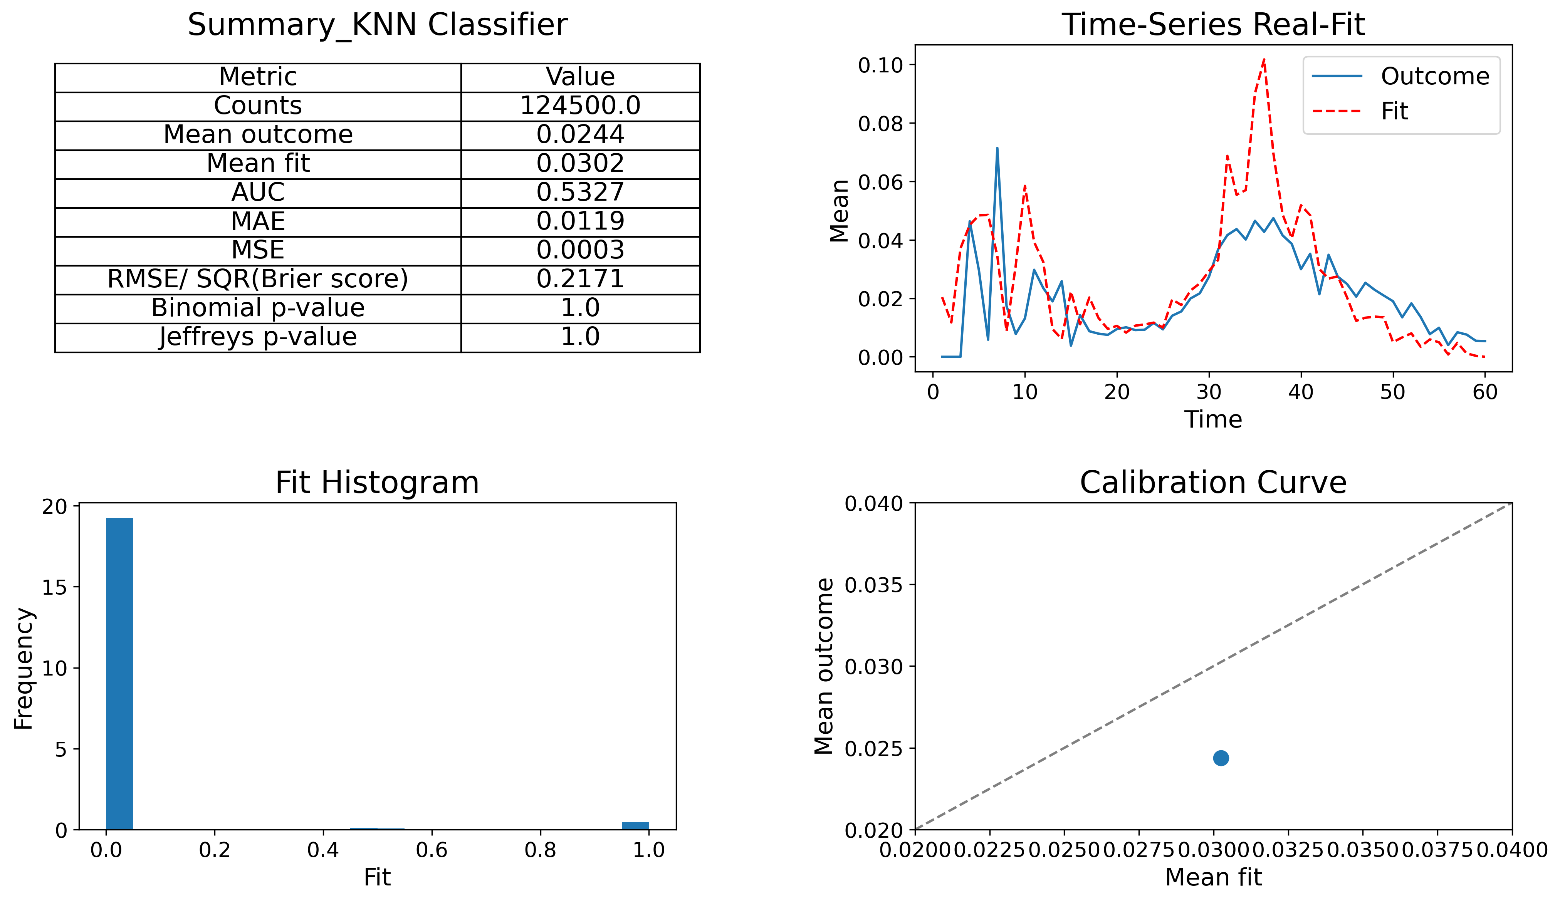
Performance evaluation (cont)

Slide 8
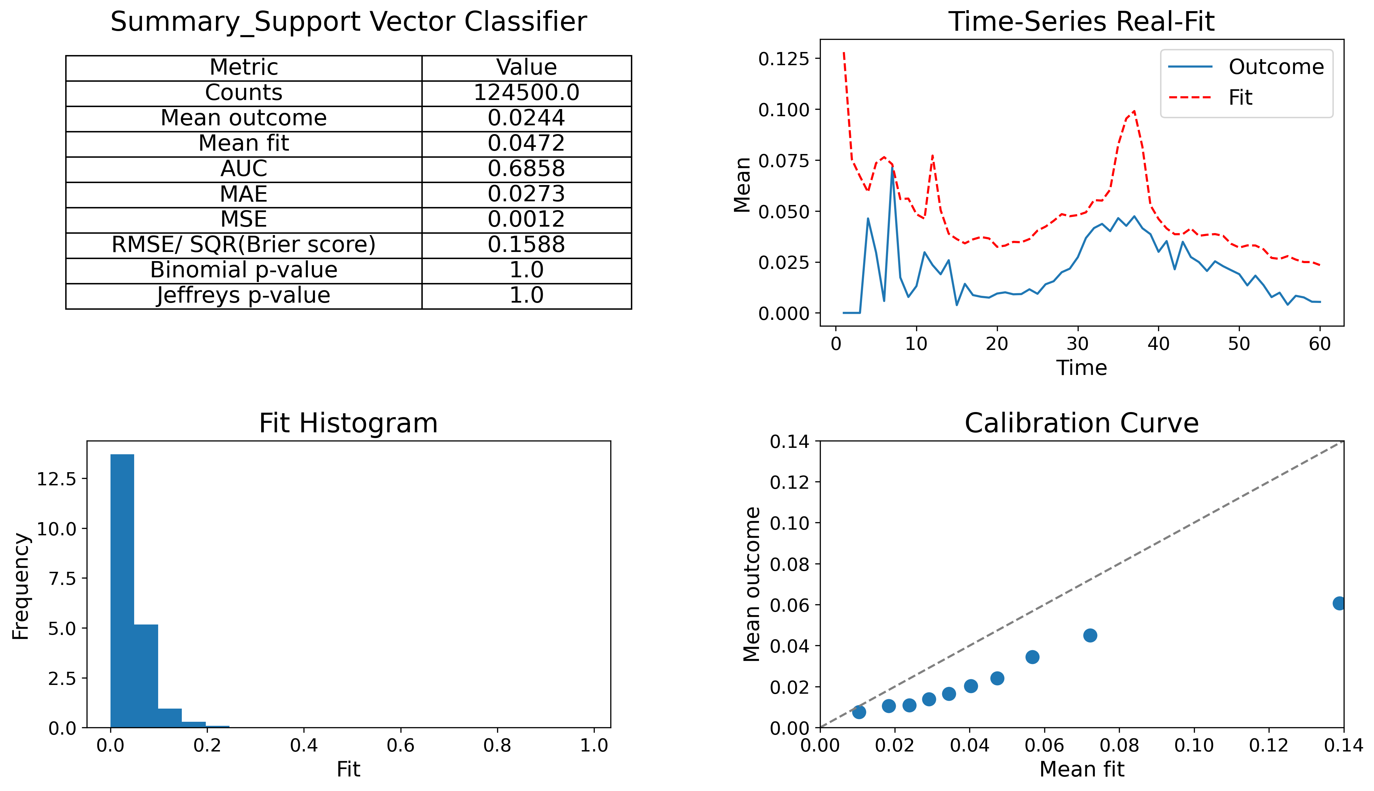
Performance evaluation (cont)

Slide 9
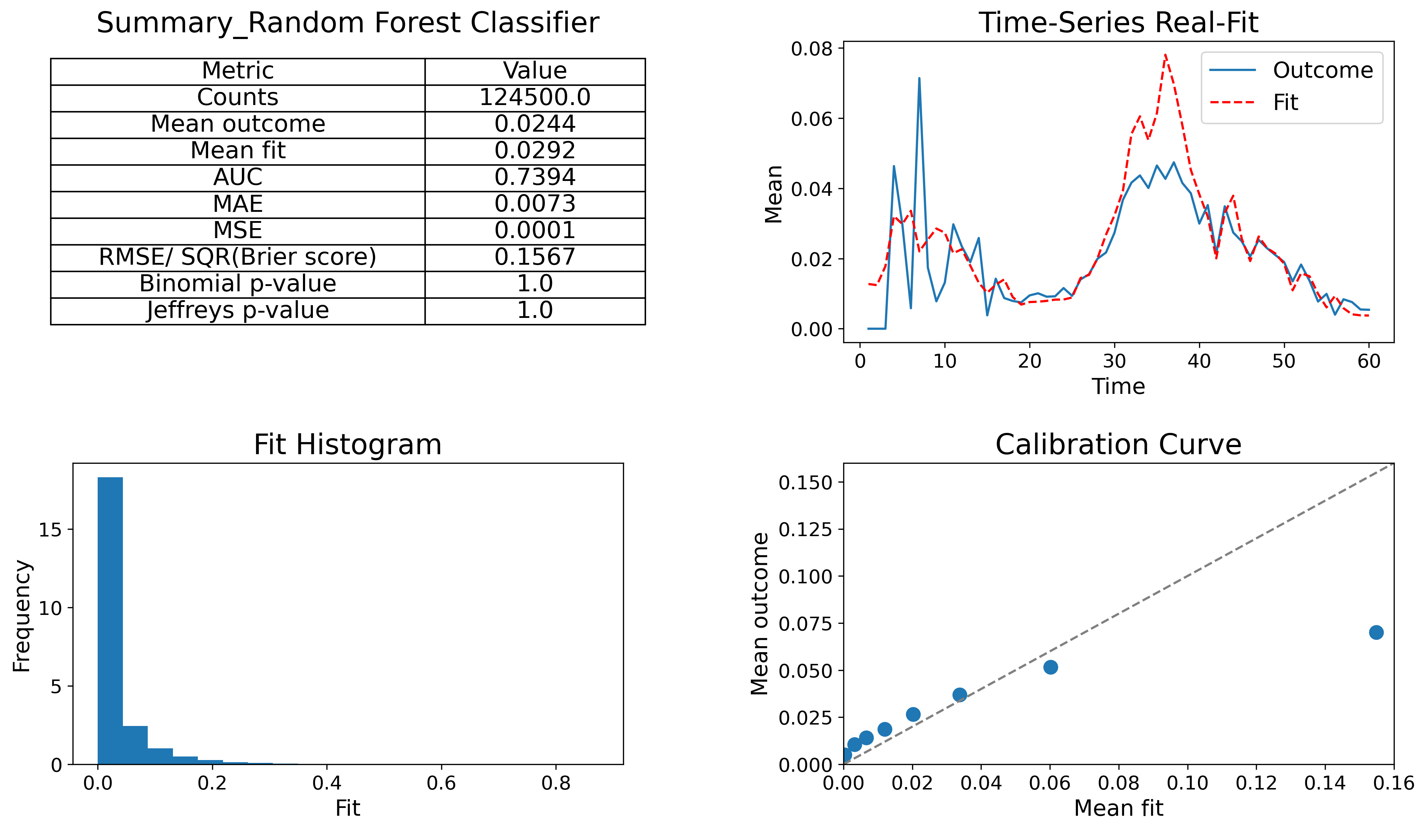
Performance evaluation (cont)

Slide 10
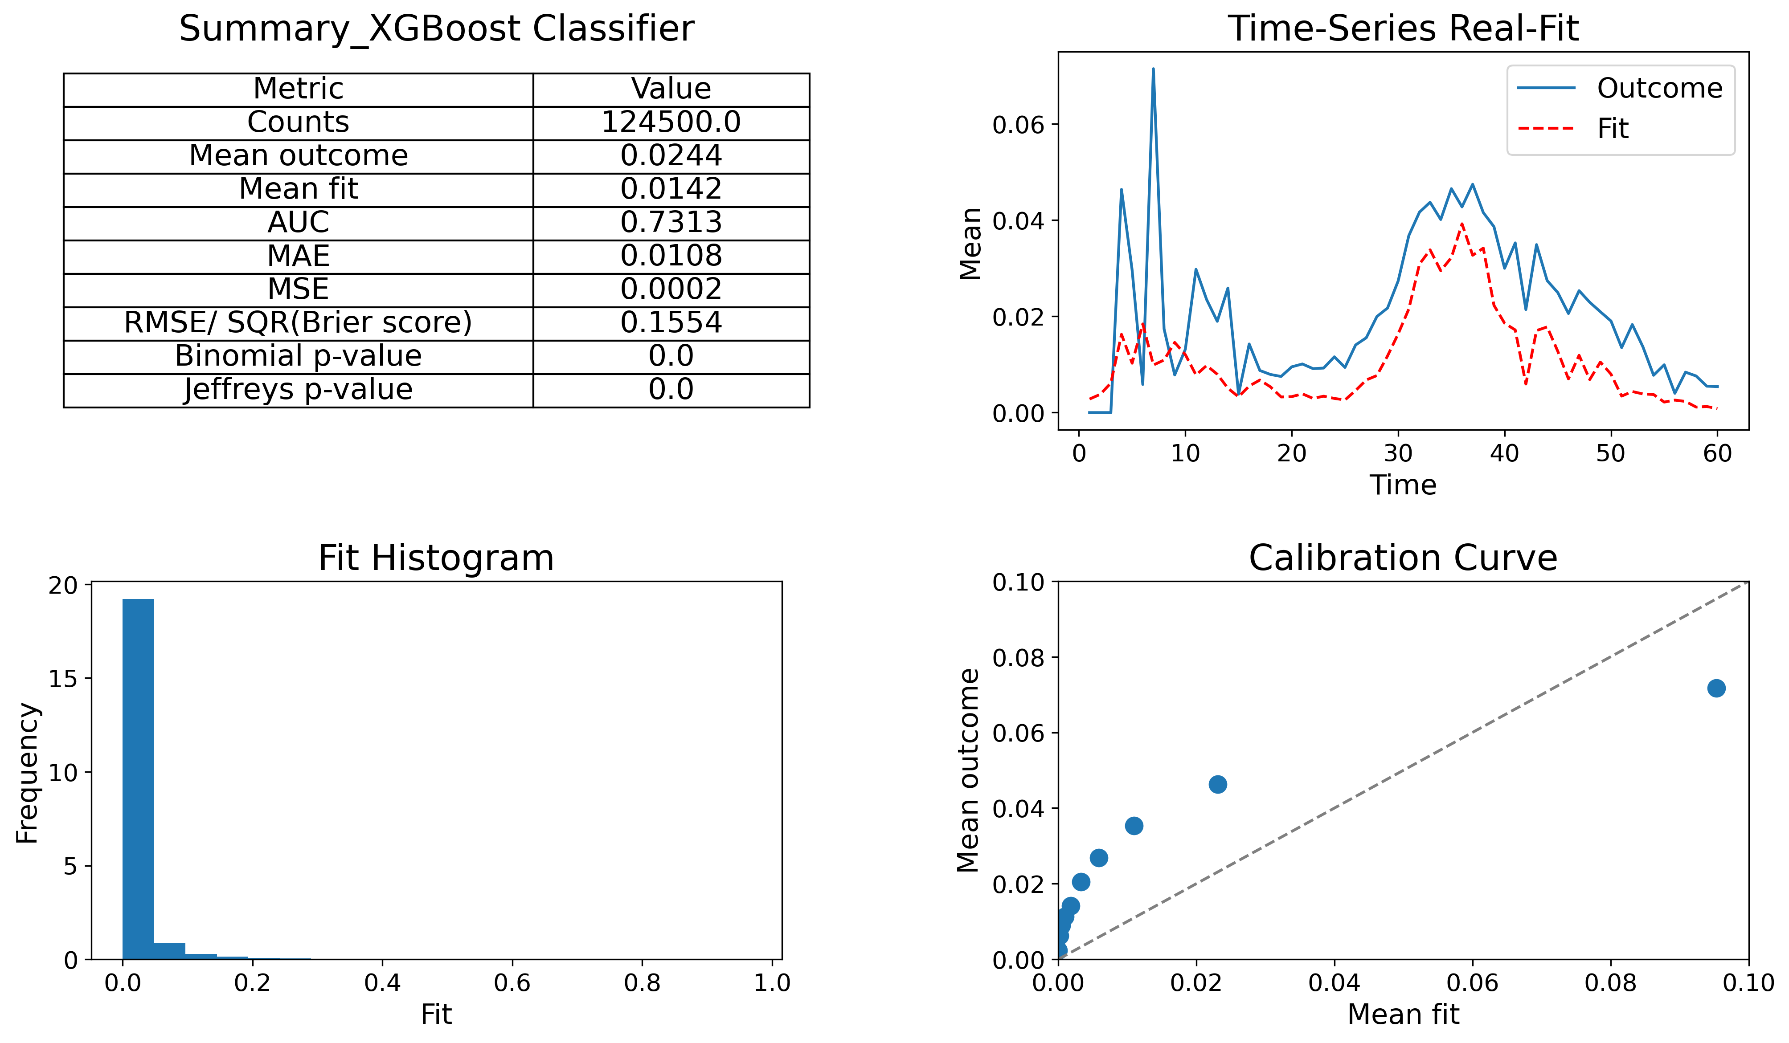
Performance evaluation (cont)

Slide 11
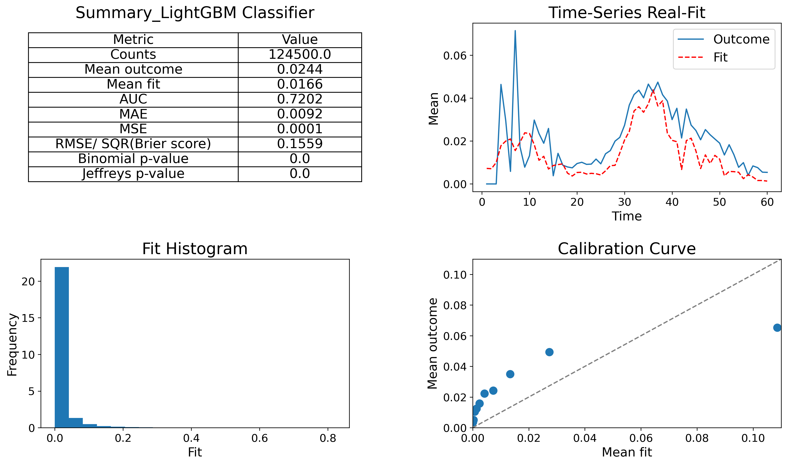
Performance evaluation (cont)

Slide 12
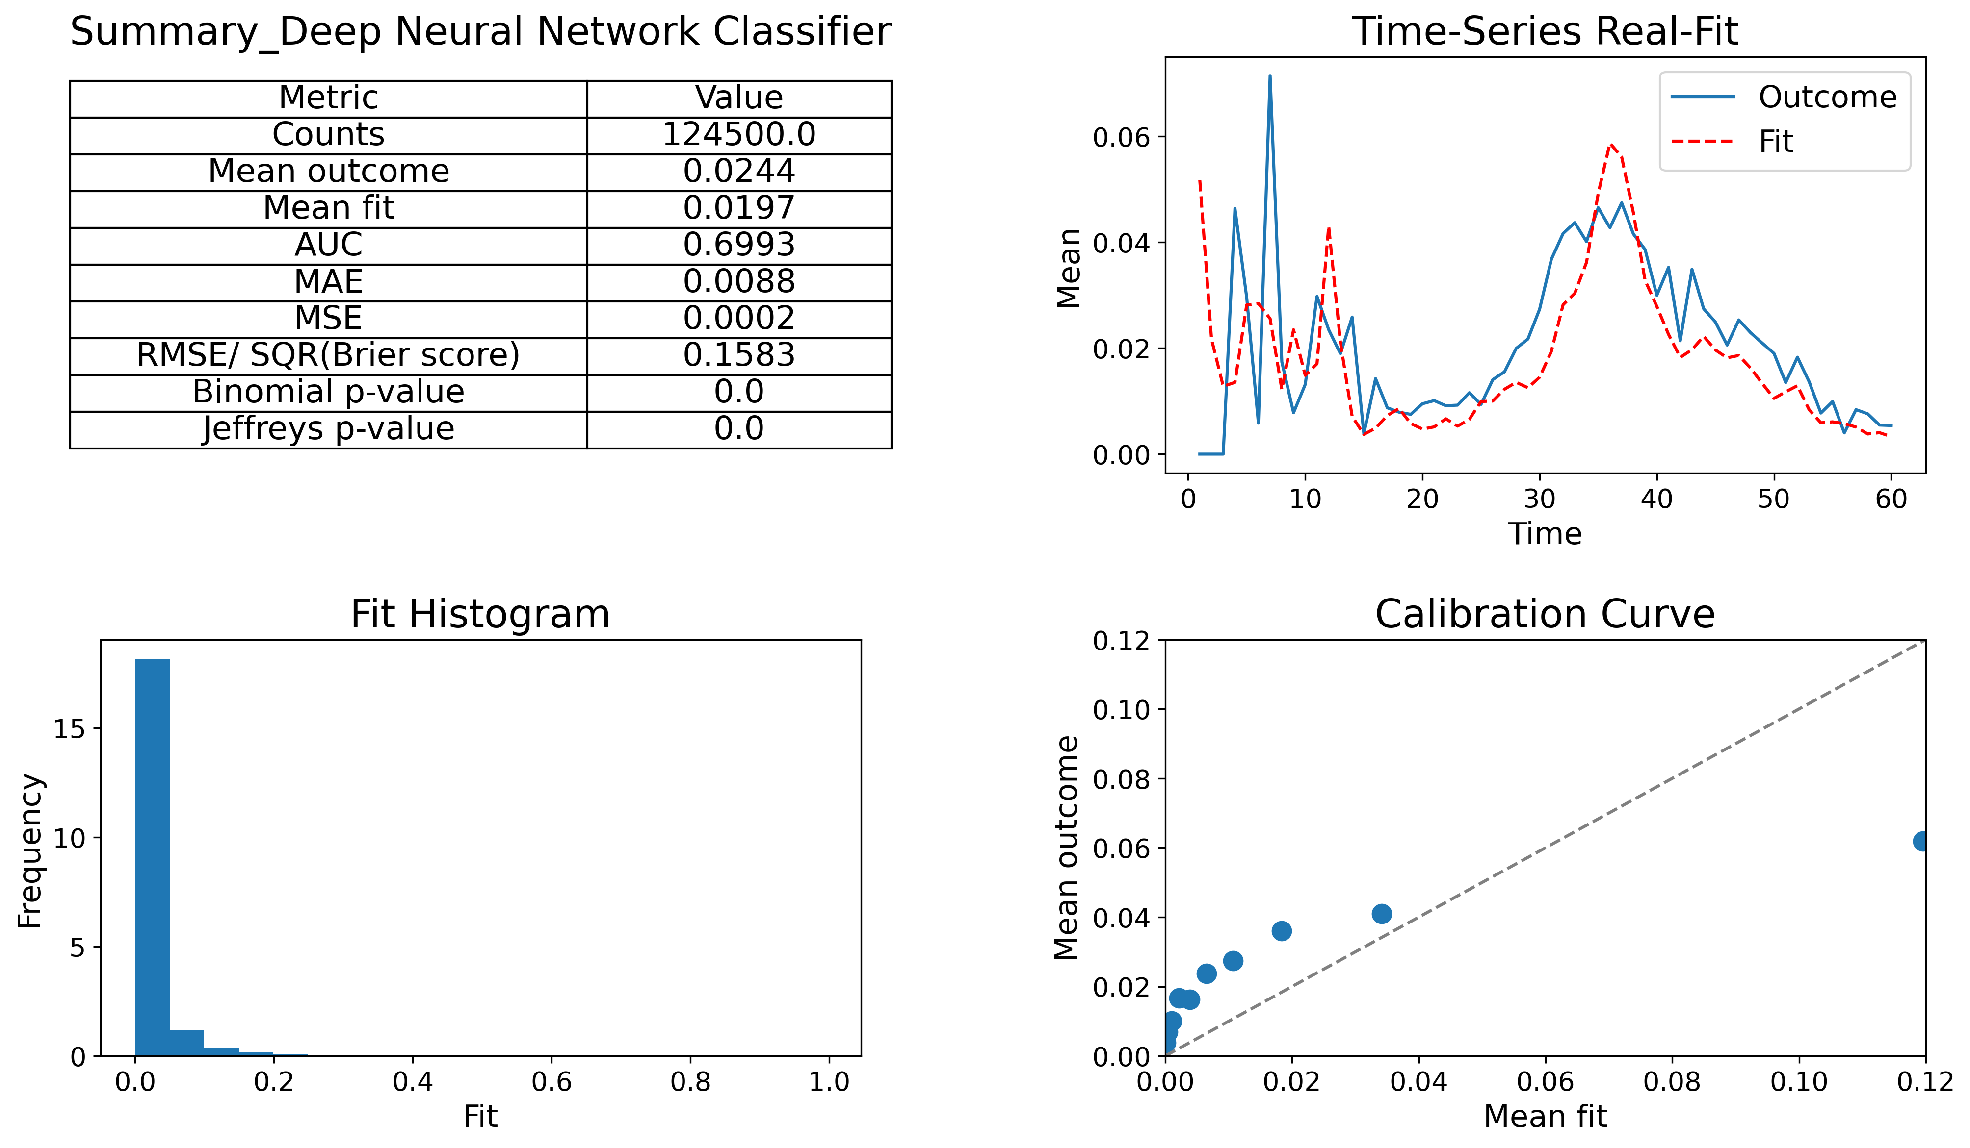
Performance evaluation (cont)

Slide 13
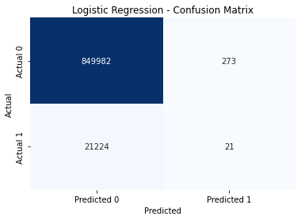
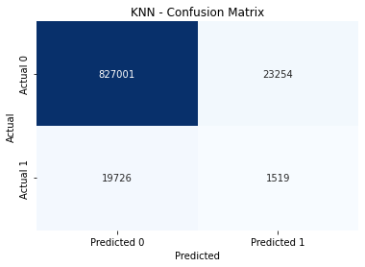


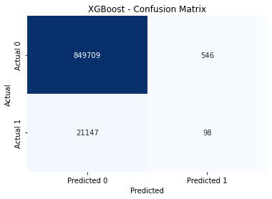
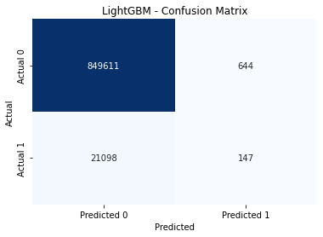
Confusion matrix

Slide 14

Confusion matrix (cont)

Slide 15
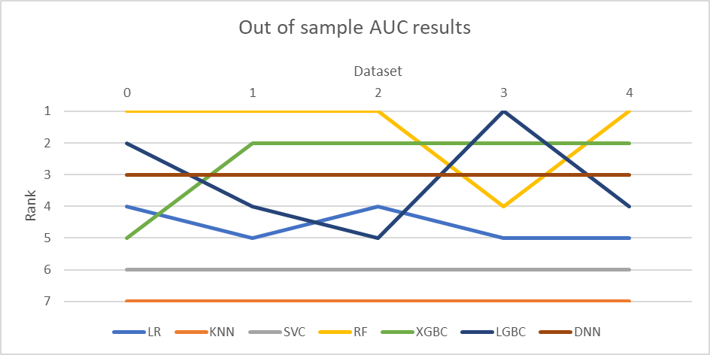
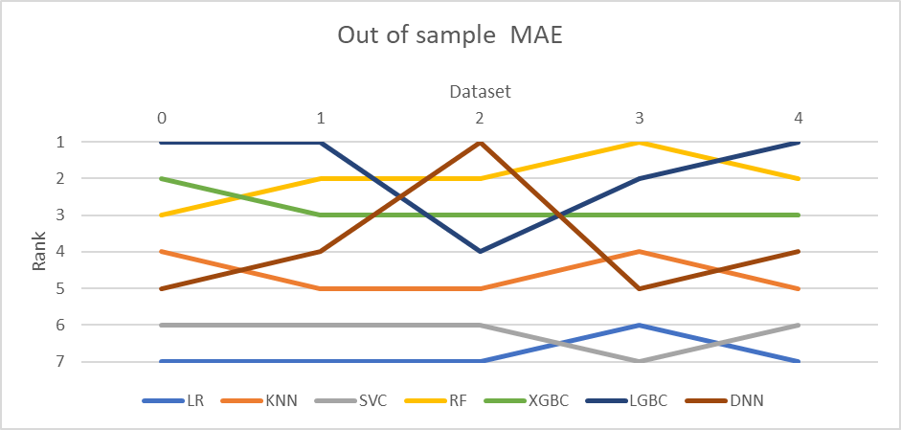
Performance evaluation (cont)

Slide 16
Result discussion
Best performer is Random Forest based on overall performance on various metrics. However, it tends to overact during stressed periods.
Logistic Regression and Support Vector Machine overshoots PD projection in their entirety of prediction.
Deep Neural Network, XGBoost and LightGBM do a decent job at forecasting but tend to underpredict PD.
KNN AUC suffers from its overfitting on training data (as a result of n_neighbors = 1 – obtained from tunning) resulting in too many actual negative cases labelled as positive and vice versa.

Slide 17
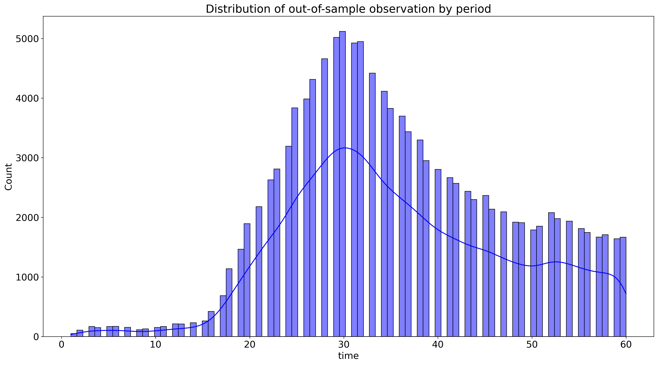
Result discussion (cont)
Model performance at early period suffers from lack of observation. As the number of observation increases, so does the accuracy of all models.

Slide 18
The end
Thank you

Slide 19
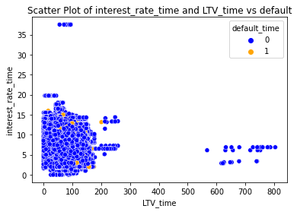
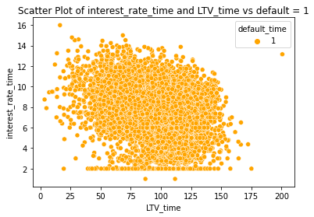
Default distribution on Current Interest Rate and Current LTV
Back

Slide 20
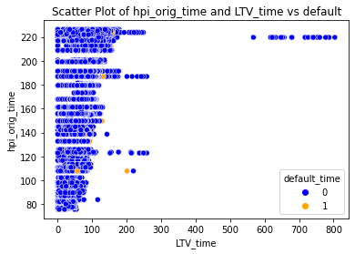
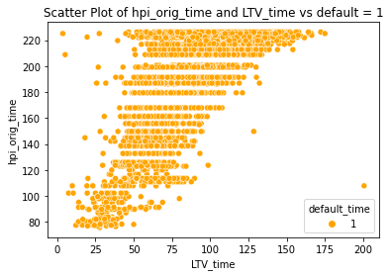
Default distribution on HPI at origination and Current LTV

Slide 21
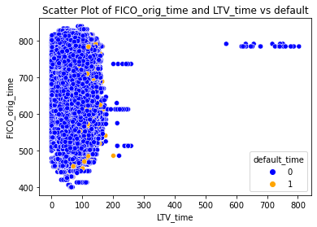
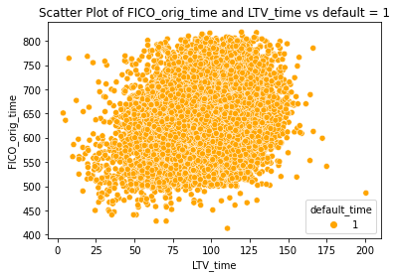
Default distribution on FICO score at origination and Current LTV

Slide 22
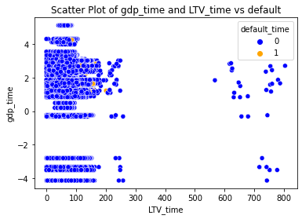
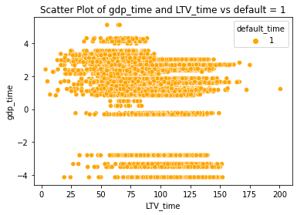
Default distribution on Current GDP and Current LTV
Back

Slide 23
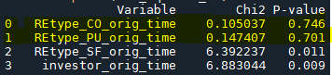
Chi 2 Independence test (Dichotomous and Categorical Variables vs. default)
Null hypothesis: There is no relationship between 2 categorical variables
Alternative hypothesis: There is a relationship between 2 categorical variables

Slide 24
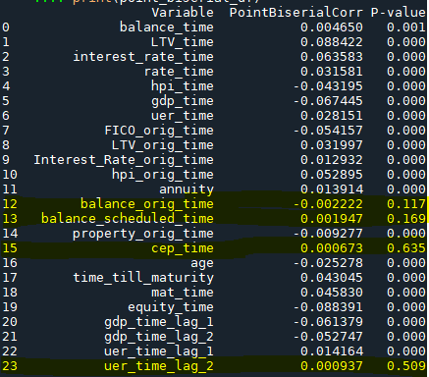
Point Biserial Correlation test (Continuous Variables vs. default)
Selection rule: significant at 5%

Slide 25
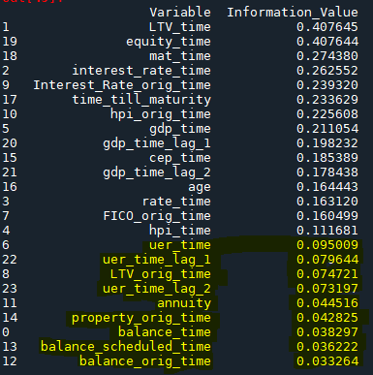
Weight of Evidence (Continuous Variables)
Less than 0.02: IV is too low to support inclusion of feature in the model;
Between 0.02 and 0.1: IV suggests a weak relation between a feature and default → consider exclusion of feature in the model;
Between 0.1 and 0.3: IV suggests a moderate relation between a feature and default → consider inclusion of feature in the model;
Over 0.3: IV suggests a strong relation between a feature and default → inclusion of feature.

Slide 26
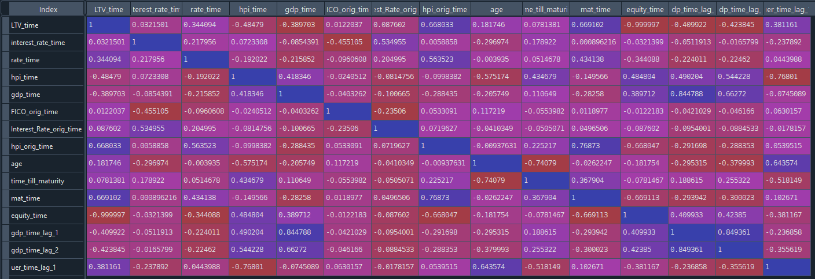
Spearman correlation (Continuous Variables)
Back

Slide 27
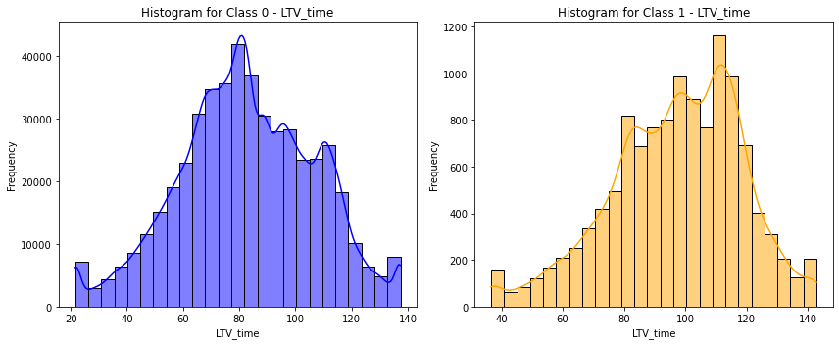
Default distribution on Current LTV
Back

Slide 28
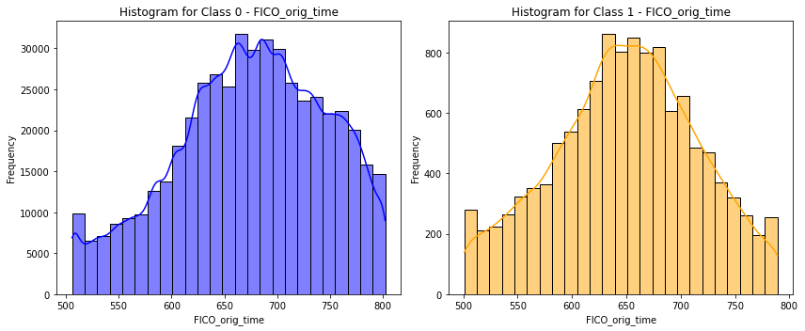
Default distribution on FICO at origination

Slide 29
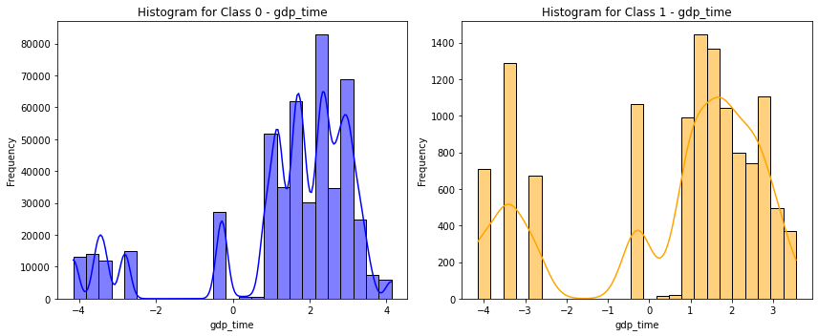
Default distribution on Current GDP

Slide 30
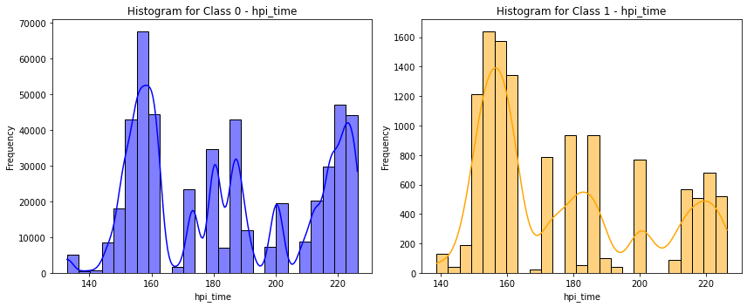
Default distribution on Current HPI

Slide 31
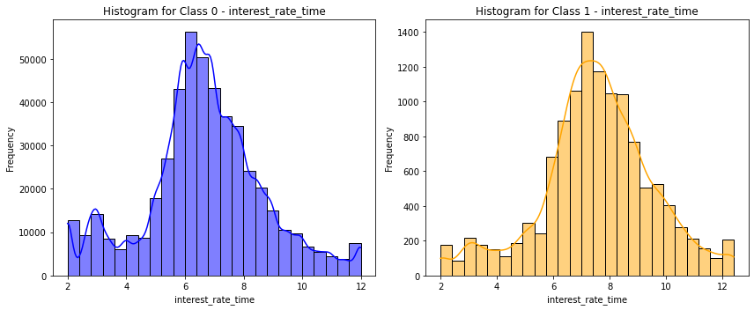
Default distribution on Current Interest Rate

Slide 32
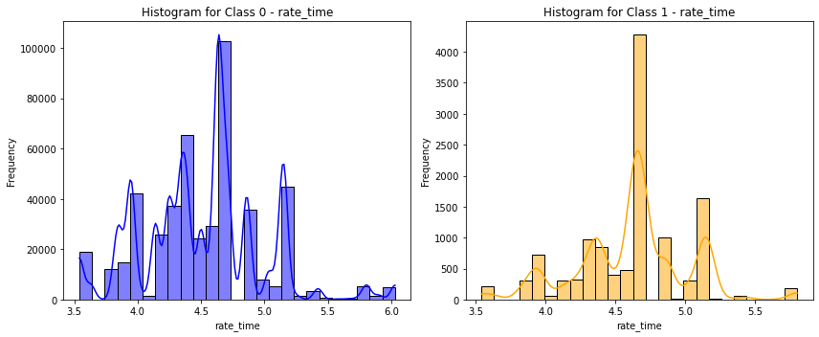
Default distribution on Current Rate
Back

